Slide 1
FAMILY &FRIENDS 1
National Edition

Slide 2
UNIT 5 : THIS IS MY NOSE!
LESSON 3 : SOUNDS and LETTERS

Slide 3
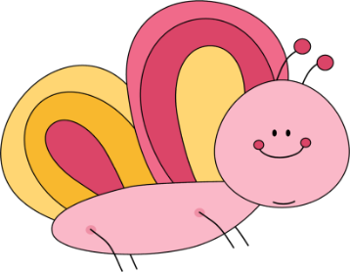
Tracing game
Notes:
Tracing on backs (a, b, c. d)
- Divide the class into groups.
- Each group makes a line, with the first student standing near the board and the last student standing near the back of the classroom.
- Pass out a phonics card to the last student of each line, but don’t have them look at the card until you say Go.
- Students “Write” the letter very slowly on their classmates’ backs with their fingers.
- The first student goes to the board, writes the letter, and says the sound. The quickest group with the correct letter and pronunciation wins.

Slide 4
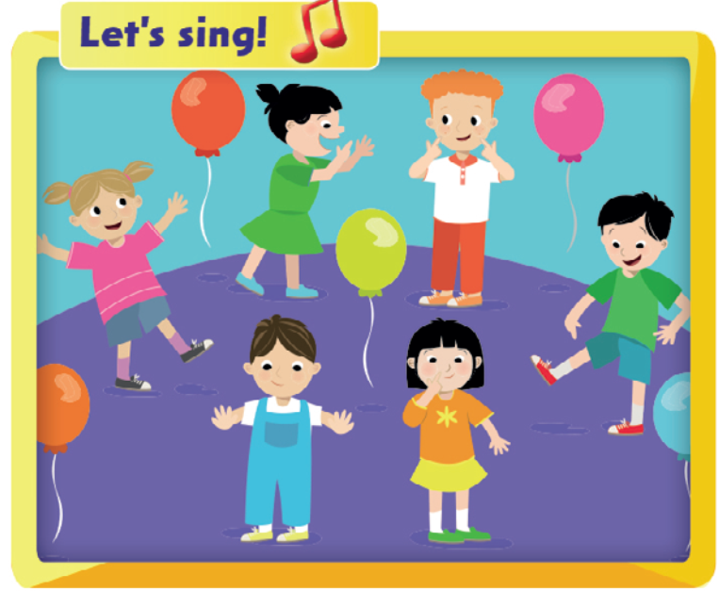

Slide 5
Notes:
- Elicit the words and sounds from students.
- Teach the corresponding letter name for each.

Slide 6
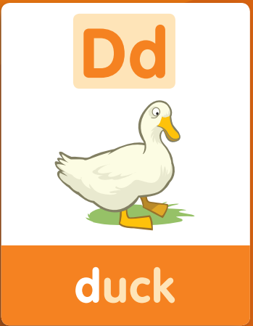
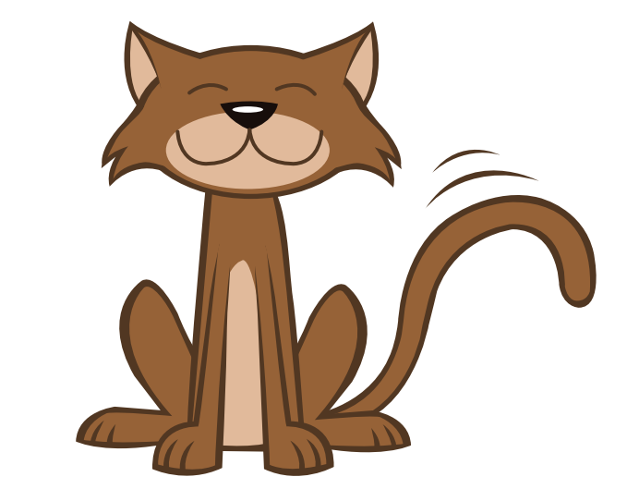
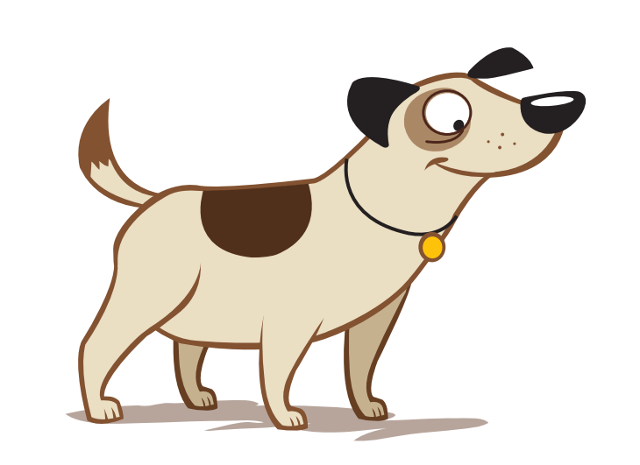

Slide 8
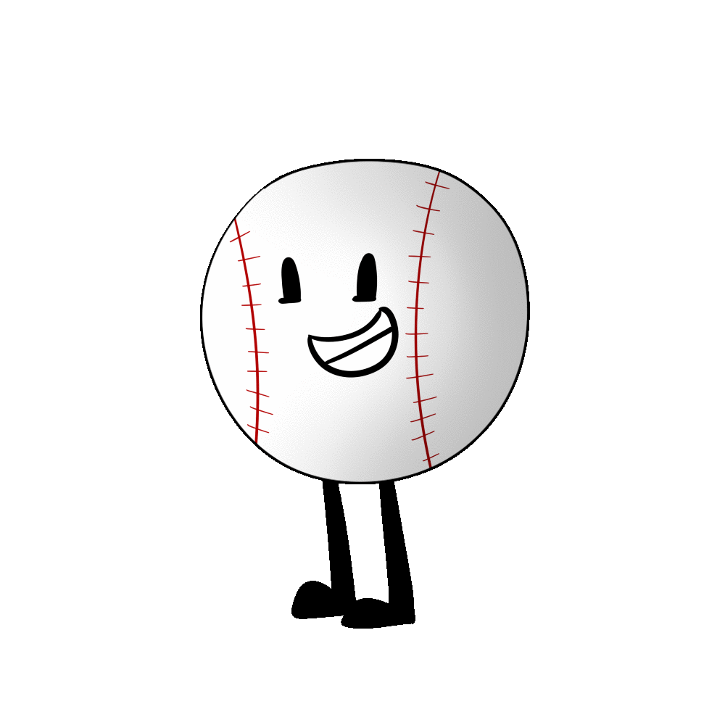
Notes:
TRACING LETTER

Slide 9
Notes:
TRACING LETTER

Slide 10
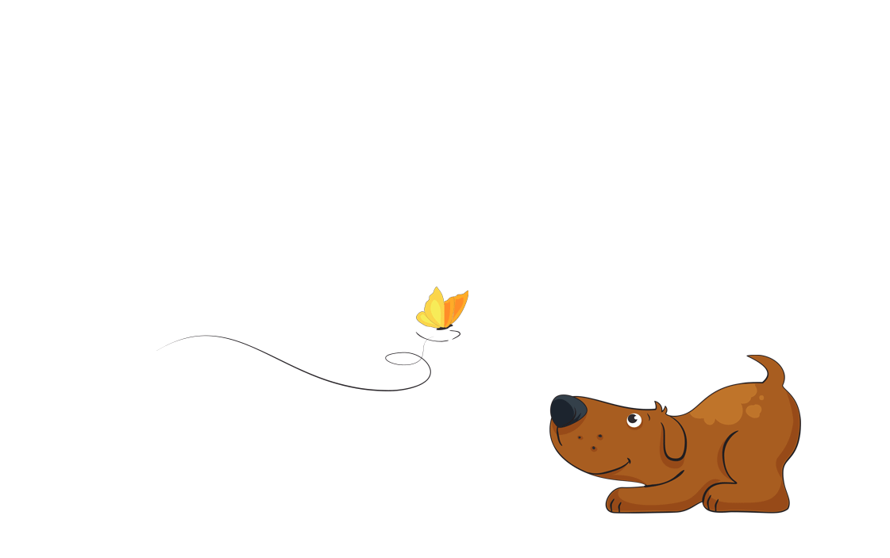
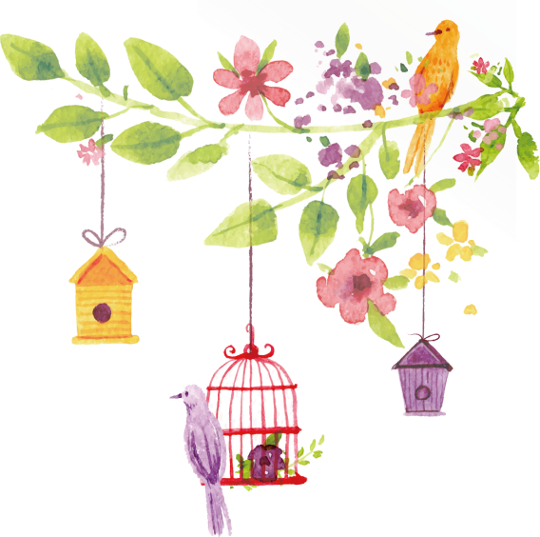
Notes:
TRACING LETTER

Slide 12
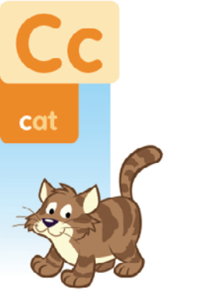
Notes:
Listen, point, and repeat. Write. Track 65
- Play track 65, listen and point
- Play again, ask students to listen and point
- Play again, ask students to listen and repeat
- Model the writing activity

Slide 13
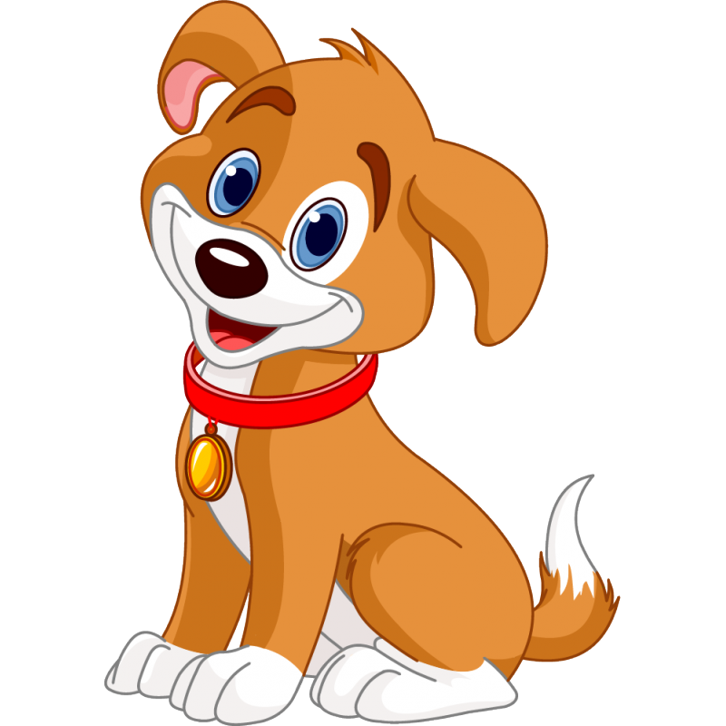
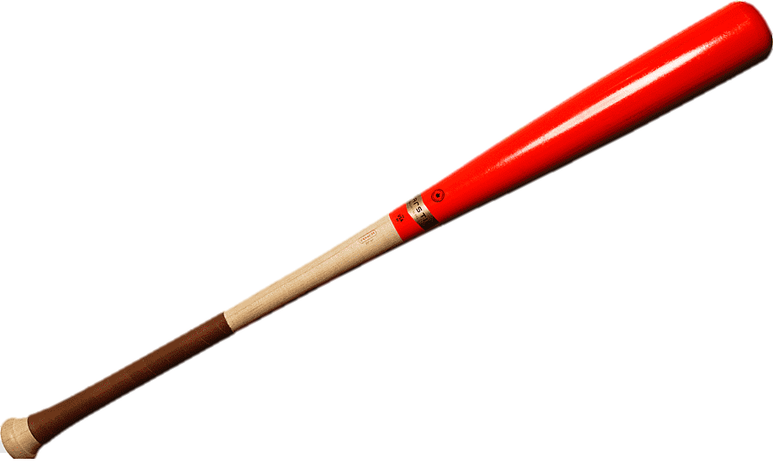
Notes:
Listen and chant: track 66
- Play the recording for students to listen to the chant.
- Put Phonics cards 1, 4, 5, 7 in different places around the room.
- Play the recording again for students to point to the cards as they hear the words.
- Play the chant once more, pausing the recording after each line for students to repeat.
- Repeat, and encourage students to follow the words in their book as they chant.

Slide 14
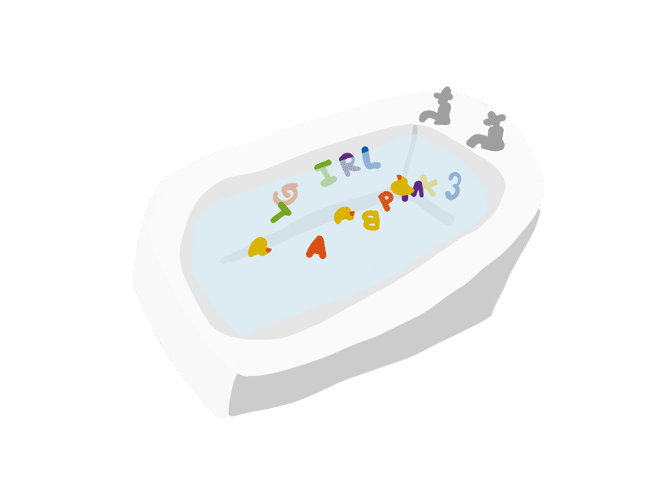
Notes:
Listen, point, and repeat. Track 67
- Ask students to look at the letters and words as you say them.
- Point out the b and the d at the end of the words and contrast them to bat and dog.
- Play the two parts of the track for the students to listen, point, and then repeat.

Slide 16
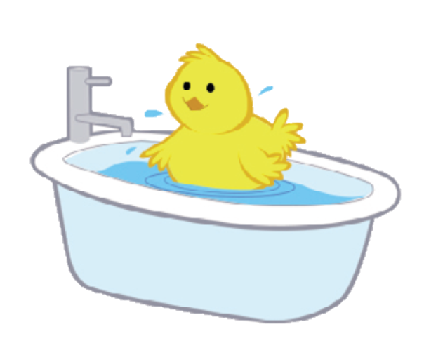
The bird is in the tub.
The bird is in the tub.
Notes:
Look and point to the sounds /b/ and /d/.
- Look at the picture and ask the students what they can see.
- Hold up the corresponding phonics cards and say Let’s find the letters!
- Read the sentence, point to the letter b and hold up the Bb phonics card. Say /b/ – bird and have the students repeat after you.
- Tell the students to follow the words in the book with their finger as you read aloud, and to put up their other hand when they see the letters b and d at the end of the words.
Below level:
- Write the words with the key letters at the start or the beginning on the board. (cat, bat, dog, apples, bird, tub).
- Say the key sound in each word (e.g. the /k/ in cat) and ask individuals to come to the board to find and point to it.
At level: Complete Exercise 4 as described above.
Above level: Teach these actions for the sounds:
/æ/: clap your hands;
/b/: tap your desk;
/k/: stamp your feet;
/d/: jump.

Slide 17
Telephone game
Notes:
- Whisper a word (apple, bat, cat, dog, tub, bird) into the ears of the first students in each row.
- They whisper the word into the next student’s ear in their row until the whisper gets to the last student in the row.
- The last student in the row has to say out the word.
- The team or teams that get the pronunciation right scores a point.

